Slide 1




GROUP 1 PROJECT PRESENTATION
Group Members:
Ebenezar Yanful Acquah
Morris Mensah
Issah Halimatu Saadia
Samuel Kwame Dassi
Akosua Yeboaa Asare
OUTLINE:
A brief introduction about the data set
Tools and libraries
Hypothesis
Questions
Visualizations and insights
Conclusions
SUPERVISOR: Godwin Kingsley Wood
DATASET: flavours_of_cacao.csv

Slide 2



A brief Information about the Dataset
Chocolate is one of the most popular candies in the world. Each year, residents of the United States alone consume more than 2.8 billion pounds resulting in a global consumption level of more than 7.2 million metric to
The dataset is about the ratings of 1795 bars of chocolate that were reviewed from 2005 to 2016 by American expects
The ratings are done on a scale of 1 to 5
There are nine columns in the dataset:
CompanyA; Specific Bean Origin; Ref; Review date; Cocoa present; Company Location; Rating; Bean Type; Broad bean Origin

Slide 3
Hypothesis
Null Hypothesis:
There is no positive relationship between the percentage of cocoa present in the chocolate bar and the expert rating given.
Alternative Hypothesis:
There is a positive relationship between the percentage of cocoa in the chocolate bar and the expert rating given.

Slide 4
Questions
What is the distribution of the ratings?
How many chocolate bars were reviewed each year?
What are the top ten chocolate-producing countries?
What is the relationship between the percentage of cocoa in a chocolate bar and rating?
What are the number of reviews per year
Which 10 companies produce most chocolate and where are they located?
Where do most cocoa beans exported to?
Which year recorded the highest and least reviews?
How cocoa intensity in chocolate has changed over time?

Slide 5
Tools and Libraries Python: Jupyter Notebook
Libraries
Pandas
Numpy
Matplotlib
Seaborn
Counter

Slide 6
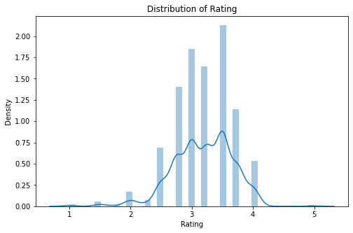
DENSITY OF THE RATING DISTRIBUTION
From the diagram(distribution) we can see that majority of the chocolates were rated between 2.8 to 4.0 with 3.6 been the most rating. This means that majority of the chocolates were rated 3.6 while few lie at the tails.

Slide 7
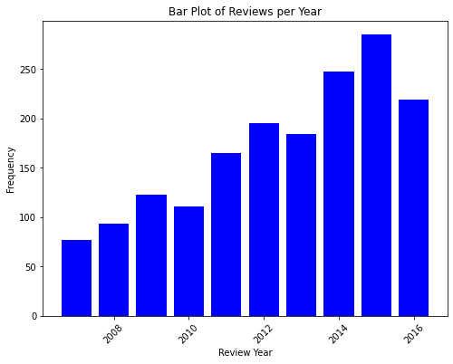
REVIEWS PER YEAR
The reviews were done from 2005 to 2016. 2015 recorded the highest number of reviews while 2005 and 2006 recorded the least.

Slide 8
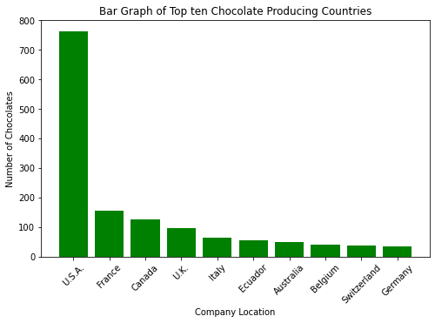
TOP 10 COUNTRIES AND NUMBER CHOCOLATES REVIEWED
From the bar graph, it is obvious that the USA is the highest producer of chocolate used for the review. It produced almost 800 bars for the review.

Slide 9
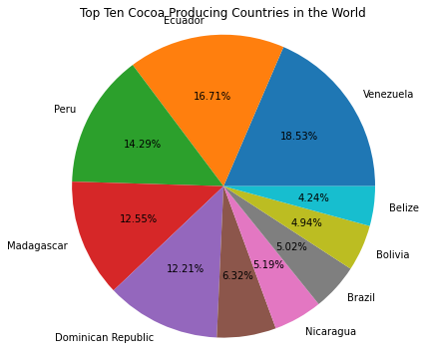
ORIGIN OF BEANS
Based on the review, the majority of the cocoa that was used to produce the chocolates came from the American continent. With Venezuela contributing more than 18% of the cocoa beans.

Slide 10
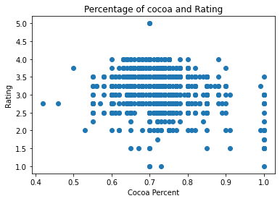
SCATTER DIAGRAM OF PERCENTAGE OF COACOA VS RATING
We also saw that there is a slight negative relationship between the percentage of cocoa in a bar of chocolate and the rating assigned to that chocolate bar. This means that other factors influenced the rating.

Slide 11
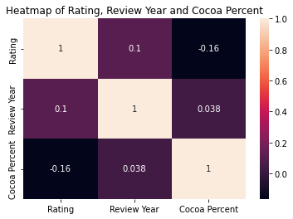
HEATMAP OF RATING VS REVIEW VS COCOA PERCENT
Review year and cocoa percent do not have much influence on the expert rating.

Slide 12
TOP 10 COMPANIES AND THEIR LOCATIONS
Company Name | Company Location | Number Of chocolate Bars Rated
Soma | Canada | 47
Bonnat | France | 27
Fresco | U.S.A. | 26
Pralus | France | 25
A. Morin | France | 23
Domori | Italy | 22
Guittard | U.S.A. | 22
Arete | U.S.A. | 22
Valrhona | France | 21
Hotel Chocolat (Coppeneur) | U.K. | 19

Slide 13
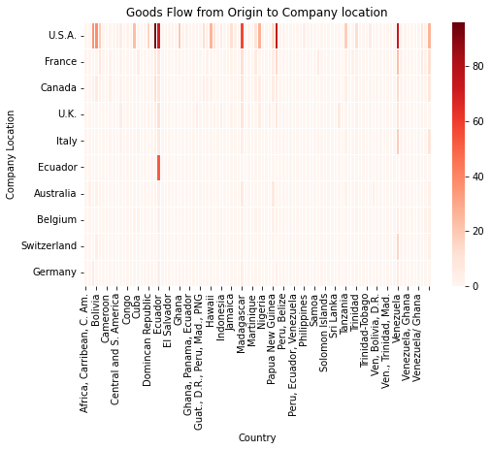
CACAO BEANS FLOW FROM ORIGIN TO COMPANY LOCATION
Most of the cocoa are exported to the USA.
But interestingly, Ecuador processed their own cocoa.

Slide 14
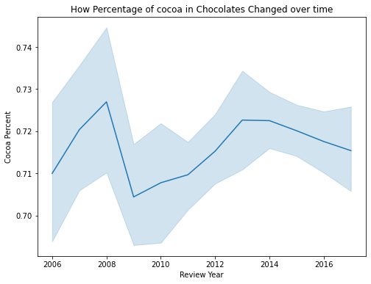
PERCENTAGE OF COCOA IN CHOCOLATE OVER TIME
The movement of the line graph indicates that cocoa processing companies vary the amount of the cacao in chocolates over time. The highest was in 2008 and the least in 2009

Slide 15
Insights from the data
Majority of the chocolates were rated between 2.8 and 4.0, where 3.6 emerged as the most rating.
Companies in the USA produced chocolates closed to 800 bars for review making them the highest chocolate producing countries compared to Germany which produced less than 100 bars for the review, making them the least out of the top ten.
Out of the top 10 cocoa-producing countries for the review, Venezuela contributed the most representing 18.53% with Belize contributing 4.24%
The percentage of cocoa present in the chocolate bar did not affect the rating the experts gave to the bars.

Slide 16
Insights from the data
From the analysis, in terms of coca beans flow from origin to the company location, most countries exported the majority of their cocoa beans to companies located in the USA.
With the top 10 chocolate-producing companies, Soma from Canada had the highest number of chocolate bars rated while Hotel Chocalat (Coppeneur) from the UK had the least.

Slide 17
Conclusions
From the analysis and visualization done, we observed that there is not much relationship between the percentage of cocoa in a chocolate bar and the rating given. Therefore, we fail to reject the null hypothesis. There are other factors that may have contributed to the rating: The expert's own intuition The flavor of the chocolate And others

Slide 18


